Slide 2








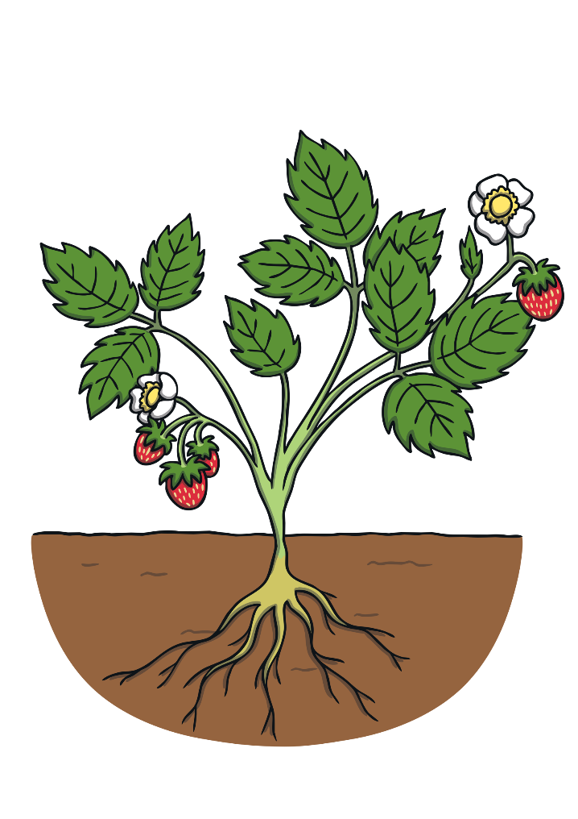


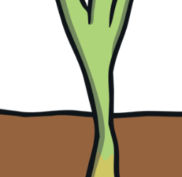
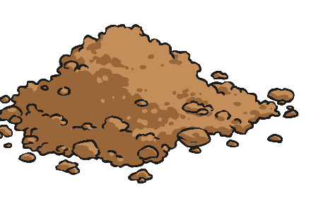

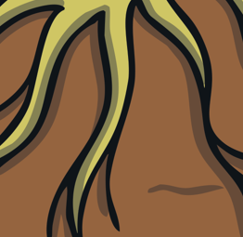
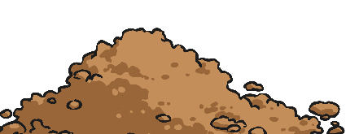
Remember It
Can you remember the parts of a plant?
Talk to your partner about each part and the job it does.
leaves
flowers
stem
fruit
roots

Slide 3
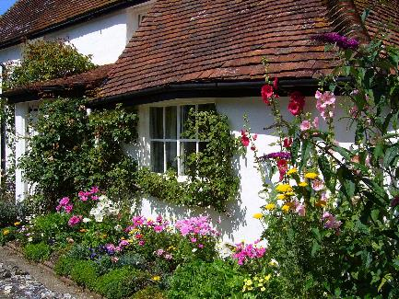
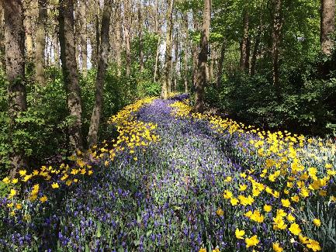
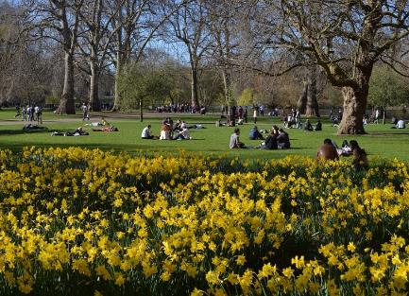
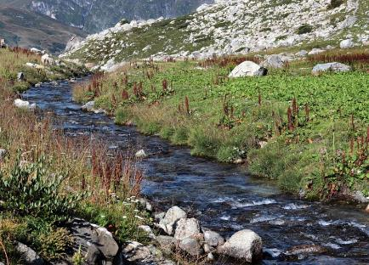
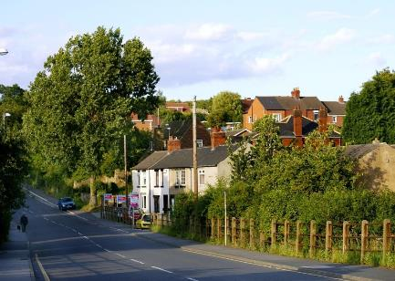
Where Do Plants Grow?
Where might you see plants growing?
Work with your partner to think of as many places as you can!
You might see plants growing:
in a garden
in woodlands
in a park
Can you think of any unusual places they might grow?
by a river
along a road

Slide 4
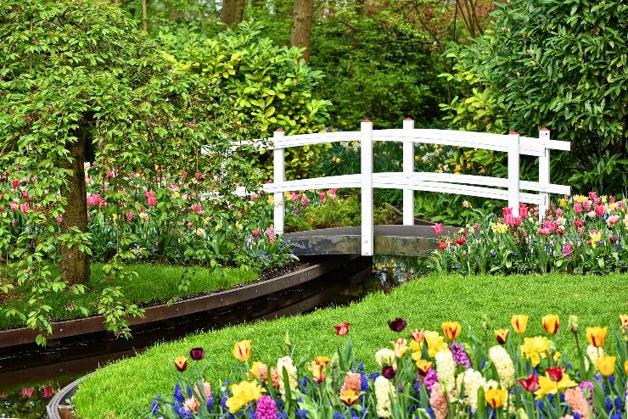
Where Do Plants Grow?
Plants that are grown in places like gardens and parks are called garden plants. These are usually planted and looked after by people.
Why do you think people might grow plants in their garden?

Slide 5

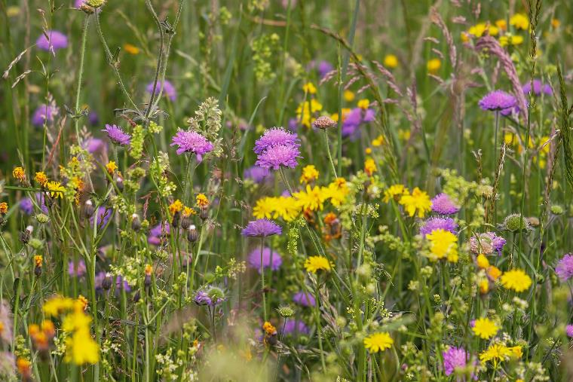
Where Do Plants Grow?
Some plants grow wherever their seeds fall. We call these wild plants.
They are not planted by people.
What do we call wild plants that grow in places we don’t want them to?
We call them weeds.

Slide 6
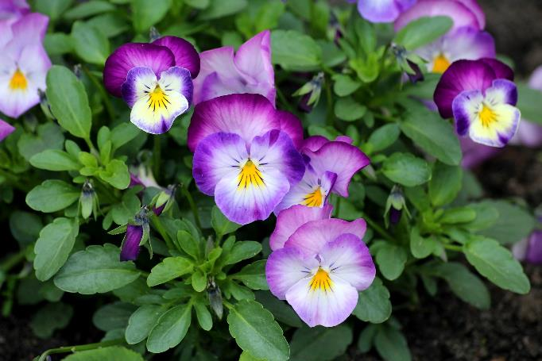
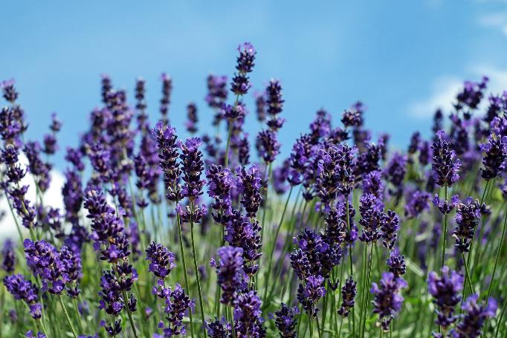
Garden Plants
There are lots of different garden plants.
Do you know the names of these plants?
These are pansies.
This is lavender.
How would you describe these plants?

Slide 7
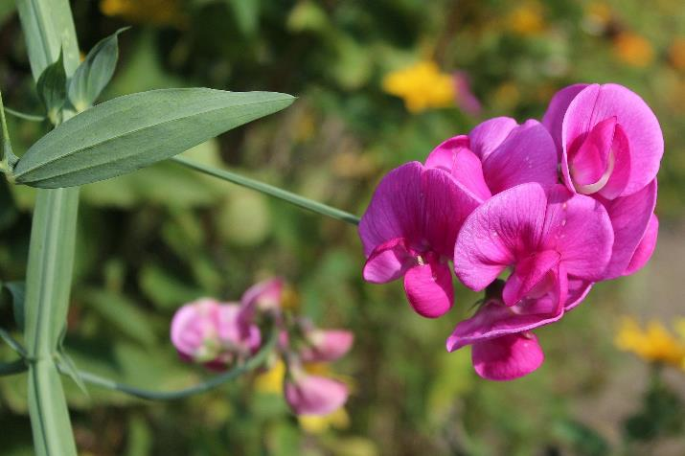
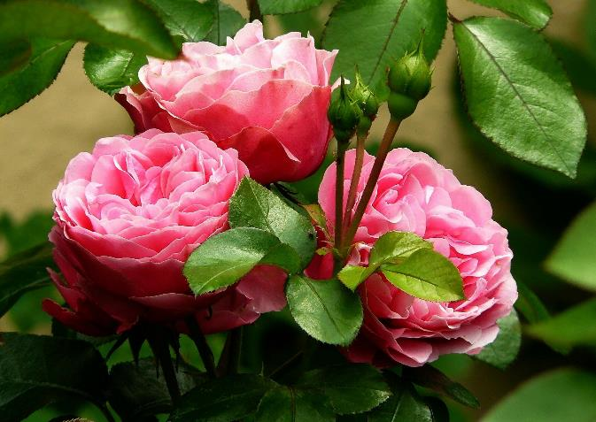
Garden Plants
Do you know the names of these plants?
These are sweet peas.
These are roses.
How are these plants similar? How are they different?

Slide 8
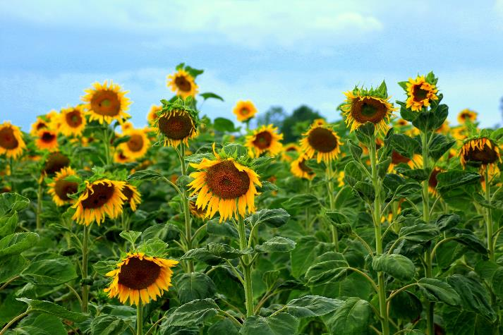
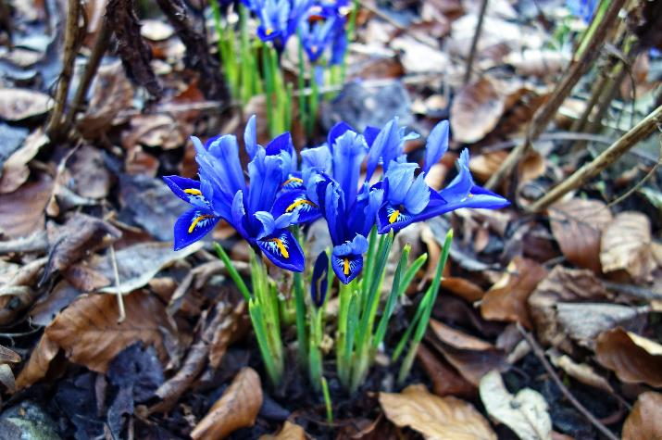
Garden Plants
Do you know the names of these plants?
These are sunflowers.
These are irises.
Have you seen either of these plants before? Where might you see them growing?

Slide 9
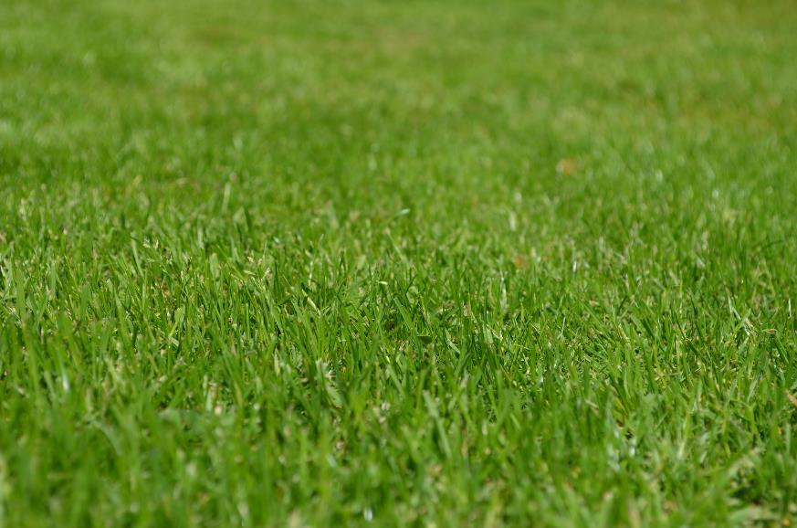
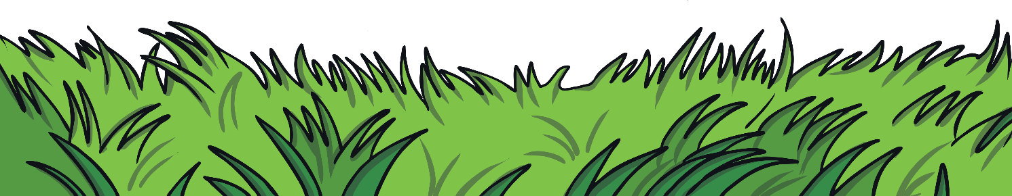
Garden Plants
Do you know the name of this plant?
Grass can be either a garden plant or a wild plant!
This is grass.

Slide 10
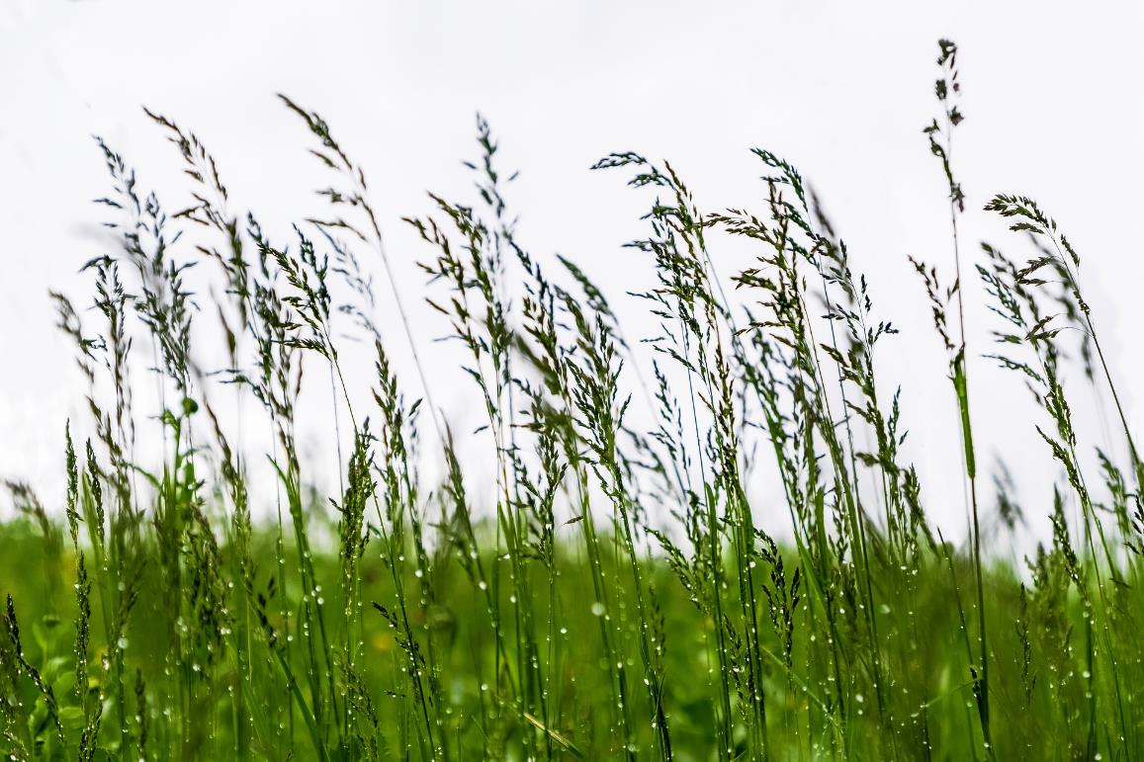
Garden Plants
Do you know the name of this plant?
This is also a type of grass! Some grass grows wild.

Slide 11
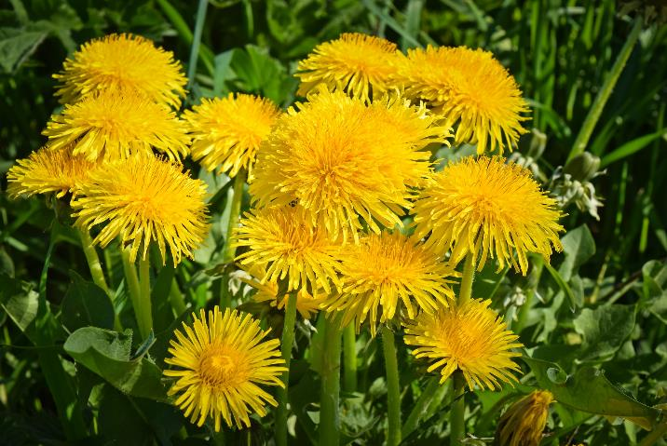
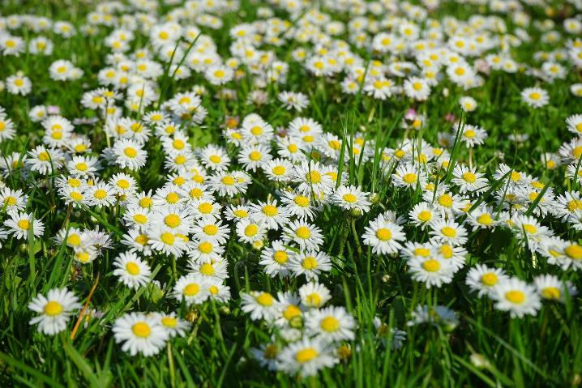
Wild Plants
There are lots of different wild plants.
Do you know the names of these plants?
These are dandelions.
These are daisies.
Where might you see these plants growing?

Slide 12
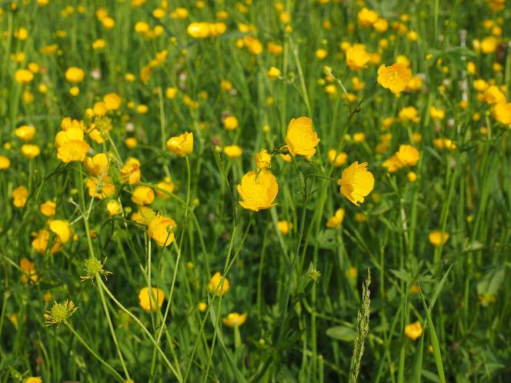
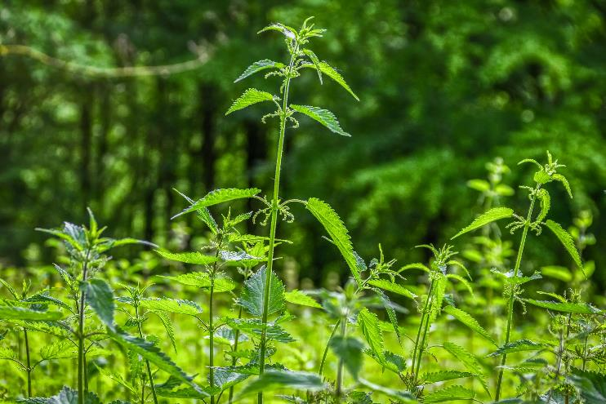
Wild Plants
Do you know the names of these plants?
These are buttercups.
These are nettles.
How would you describe these plants?

Slide 13
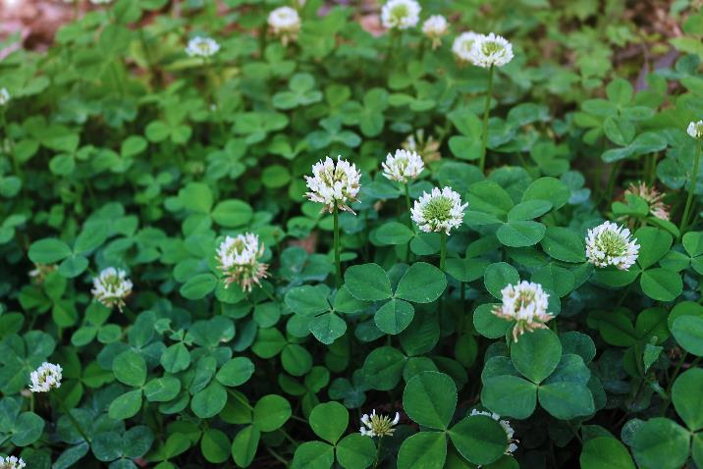
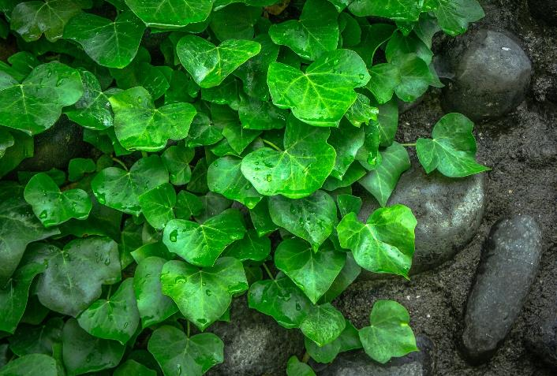
Wild Plants
Do you know the names of these plants?
This is clover.
This is ivy.
Where might you see ivy growing wild?
Like grass, ivy can be either a wild plant or a garden plant.

Slide 14
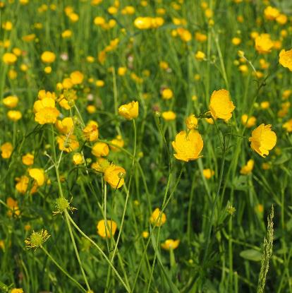
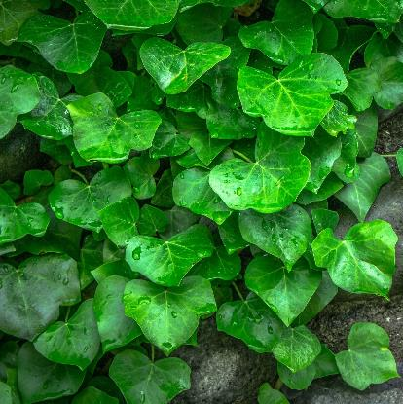
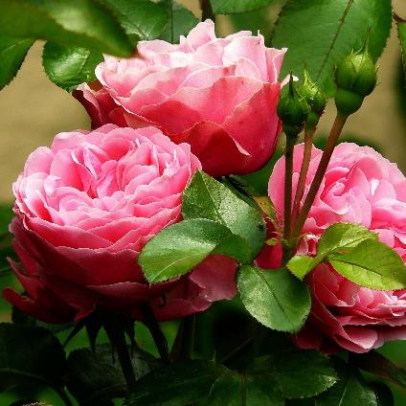
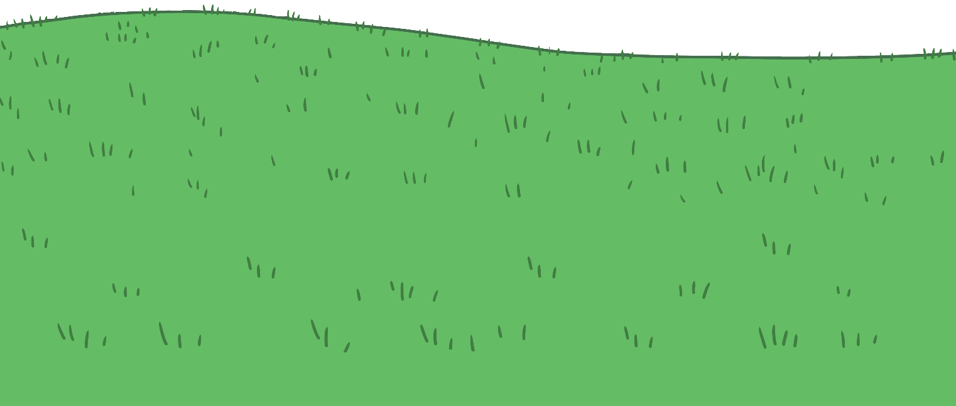
Types of Plants
What are wild plants? What are garden plants?
Can you remember the name of any?
A wild plant is a plant that grows without help from people.
Some plants can be wild plants and garden plants.
A garden plant is planted and looked after by people.

